Slide 1
ASEM Drop Shipment Process
FGI Receiving Process
Order Receiving Process
Picking Process
Packing Process
Invoicing
Outer Box Labeling
Final Lot Ship
Prepared by Chong Kim Chor (ASEM-IT)
1

Slide 2

FGI Receiving Process
ASE System
ASEM Current Process
Avago Requirement
Test Mfg
Shipping Dept
Put away transaction: Track Out lot from FGST by selecting ASE LotNo, key in seal date & Shelf Loc
ASEM should scan the INN_GEN1 label lot number and LPN (license plate number or box id) to do the put away transaction in ASEMs Warehouse Management System
Enhancement on current pick/pack scan to cater for this request. Refer to slide 3/4.
MES (Factory Works)
Lot completed
post test
Shipping team go to FW system, track out the lot from FGST step.
(ASE Lot No, Shelf Loc and Seal Date
Transfer logsheet and Traveler attach together with physical lot send to shipping dept
Receive physical lot
Test Operator fill up transfer logsheet (ASE Lot No, No of Box, Qty)
Base on the Transfer LogSheet, Shipping Dept verify the physical box label vs process traveler.
(ASE Lot No, Trace Code/Cust Lot No, Customer Device and Qty)
Shipping team put away the lot into warehouse. Write down Shelf loc and Seal Date on the transfer logsheet.
Follow ASEM.
Manual Process
Verify transfer logsheet, inner box label and Traveler manually
Store physical lot into warehouse
SAP
Lot details updated in SAP
After track out the lot from FGST, lot details updated to SAP (real time). Lot trigger billing process.
Follow ASEM.
Logistic & Invoicing System (LI)
LI system pull Lot details from SAP system every half and hour.
Daily FG Inventory report send to customer.
Lot details updated in LI System
Auto send FGI Report to Customer
Follow ASEM.

Slide 3
Customer Order Receiving Process
System
Customer
Auto Process
Shipping Dept
ASEM Current Process
Avago Requirement
Customer will ftp ship request file to ASEM FTP server.
Avago Larva system – Pick Slip file
Q: Is that possible to include ASE Lot No in the pick slip file? All ASEM system are using ASE Lot No as the key. Shipping team need this info available in the pick slip file for the remaining process.
Avago will send pick slip file which is different format from ASEM standard format.
Avago will send sample file with data to ASEM to review.
AR: Juan (Avago)
ASEM need to create an auto job to download required info into LI system.
AR: KimChor (ASEM IT)
Time Line: 15-Jul
Customer System
Ship Request from Customer
FTP Pick Slip file to ASEM FTP server
Logistic & Invoicing System
Schedule job to read the pick slip file into LI System
A schedule job will load the pick slip file into ASEM LI system.
At the same time, LI system will create the internal ship request file in pdf file and auto send email to shipping team.
(Ship Req ID, DO, Ship To, Bill To, SO No, Cust Part No, Cust PO, Total Order Qty, Unit Price, Line Item, Ship Lot No (ASE Lot No), Lot Qty, Shelf Loc & etc)
Follow ASEM
Print out Internal Ship Request File
Generate internal ship request file in pdf format, send to shipping team by email
Assign Invoice for each Ship Req ID
Manually write Invoice No in the Ship Request document
Shipping team receive Ship Request and print out.
Assign Invoice to each Ship Request ID in LI system. One invoice to one ship request ID.
Continue to Picking Process

Slide 4
Picking Process
ASEM Current Process
Avago Requirement
System
Shipping Dept
Logistic & Invoicing System
Physical Ship request document
Follow ASEM.
Based on the ship request date, pick the lot from warehouse into trolley.
If lot splitting is required, relabeling and QA buyoff process will be done. Then continue with pick scan.
Manual Process
Retrieve lot from warehouse, pick physical lot into trolley
Lot Splitting?
Yes
Follow ASEM.
Relabeling & QA buyoff
No
Pick Scan screen in Label printing system, shipping team scan the ship request id from ship request file, ASE lot no and qty for every box from inner box label.
Print out ship request label to stick on the outer box
Required to scan cust lot id & LPN from inner box label.
Enhance pick scan screen to scan the 2D barcode from inner box label. Verify cust lot id, LPN and qty.
AR: KimChor (ASEM IT)
Time line: 15-Jul
Pick Scan Screen:
Scan ship request id from Ship request file
Scan ASE Lot no & qty from inner box label for every box
FactoryWorks (Label Printing)
Print Ship Request label after all boxes being scan
Stick ship request label onto outer box.
Summary:-
Lot Splitting is possible in FGI where relabeling process is needed.

Slide 5
Packing Process
ASEM Current Process
Avago Requirement
System
Shipping Dept
QA
Pack Scan screen – Scan in Ship Req ID, Scan every inner box, Box ID & Qty
Shipping team prepare Packing Instruction in FOMS system. Scan in Ship Req ID, assign ASE Lot No into every outer box no.
Print out Packing Advice from FOMS.
FGI Outbound Matching System (FOMS)
Prepare Packing Instruction
Until all boxes scan for the outer box, qty matched
Enhancement to pack scan screen to scan 2D barcode and validate cust lot id, LPN and qty.
AR: KimChor (ASEM IT)
Time line: 30-Jul
Scan Ship Req ID, invoice # auto pull. Assign ASE Lot No into the Packing Advice
QA go to Pack Scan screen – Scan in Ship Req ID, and scan every inner box (Box ID & Qty).
Until all outer boxes scanned and the total qty matched, QA key in their password to complete the scanning.
Print out Packing Advice
Key in QA password to complete the scanning
Manual Process
Load inner box into outer box
Based on the Packing Advice, shipping team pick the inner box, weight the net weight, write the net weight on the Packing Advice.
Load inner box into outer box. Completed one outer box, weight the gross weight and write on Packing Advice.
QA perform Pack Scan for every inner box. All boxes matched, shipment team will seal the outer box.
Repeat the same process until all outer boxes sealed.
Based on the Packing Advice, pick the box
Follow ASEM.
Until all inner boxes loaded into outer box, weight Gross Weight & write on the Packing Advice
Weight the net weight, write on the Packing Advice
Repeat the same process until complete all outer box
Seal the outer box
Manual Process
Outer box will put into the staging point
Packing Advice will be sent for invoicing
Shipping team seal the outer box.
Outer box and put into the staging point.
Shipping team send Packing Advice for invoicing.
Follow ASEM.

Slide 6
Invoicing Process
System
Shipping Dept
ASEM Current Process
Avago Requirement
Add ASE Lot No into the Invoice. System cross check with FOMS to ensure the correct ASE Lot No scan into the invoice
Scan Invoice No from packing advice
Scan in invoice no from packing advice.
Assign ASE Lot No into the invoice by scan in every ASE Lot No. LI System will cross check with FOMS system to ensure the correct ASE Lot No & Qty are scanned.
Key in # of outer box, pack qty for every inner box, net & gross weight into LI system.
Go to Pre-Ship Alert screen, ensure all FGI Term and Packing information are populated (Pick Slip File & FOMS).
Print out Invoice and Packing List from LI System.
Fold Invoice & Packing List into the shipping pouch to be place on the outer box.
Follow ASEM.
Logistic & Inventory System (LI)
Key in # of outbox, Pack qty for every inner box, net & gross Weight into LI system
Go to Pre-Ship Alert screen to ensure all FGI term and packing information are populated to LI System
Print out Invoice & Packing List from LI system
Fold Invoice & Packing List into Shipping Pouch

Slide 7
Outer Box Labeling Process
ASEM Current Process
Avago Requirement
System
Shipping Dept
QA
Go to LPS system
Scan in Invoice No from Packing Advice
Login to Shipment Validation Control in LPS system
Shipping team login to LPS system,
Scan invoice no from packing advice.
System will pull all required information from LI & FactoryWorks system.
Print out outer box label from LPS.
Shipping team stick the outer box label on outer box.
Send for QA buyoff.
QA login to LPS system – Shipment validation control screen, Scan in the ship id (ship req id/cartoon no) from ship request label and shipment label. Both have to matched. All shipment related information will be auto pull.
QA buyoff to ensure all shipment out with the correct shipping document & labels.
QA click the Shipment Pass button after the verification process. QA Stamp the QA pass on the outer box label.
Avago to provide the outer box label spec.
ASEM required lead time 3 weeks to create 1 end customer label in LPS system.
Enhancement required in Shipment Validation control, pending outer label spec from Avago.
FactoryWorks Label Printing System (LPS)
All required info will be auto pull from LI & FW
Scan ship request label, outer box label, all info auto populated for QA buyoff
Print out Outer Box label from LPS
QA click the Shipment Pass button after confirm all shipment document is correct
Stick label on the outer box
Stamp QA pass on the outer box label
Proceed to shipping

Slide 8
Final Lot Ship Process
ASEM Current Process
System
Shipping Dept
Auto Process
Avago Requirement
Go to LI system
Scan in Invoice No from Packing Advice
Once the goods picked up by forwarder, ASEM required to send the SHIP_CMN file to customer within the next hour. ASEM send ship alert/ship confirm file once a day. Need a schedule job to run every hour to check any ship lot and generate the ship confirm file according to Avago required format.
AR: KC (ASEM IT)
Time line: 15-Aug
Ship alert to Avago end customers. ASEM standard practice we doesn’t liase with Avago’s customer directly. Hence we cannot support ship alert to Avago’s customer.
Logistic and Invoicing System (LI)
Shipping team login to LI system, scan in the invoice no from packing advice. All info auto populated.
Go to Pre-ship alert screen, select the shipment method (air/sea/others), select forwarder and check the ETA to ship the lot.
Goods are ready to pick up by forwarder.
Go to Pre-ship Alert screen
Select shipment method, forwarder, check the ETA and ship the lot
Goods ready to be picked up by forwarder
Various Systems (SAP, FW, FOMS, PT)
Once the shipment done, the shipment information from LI system will transfer back to various internal system like SAP, FW, FOMS and PT.
Shipment data interface to various internal systems
Follow ASEM.

Slide 9
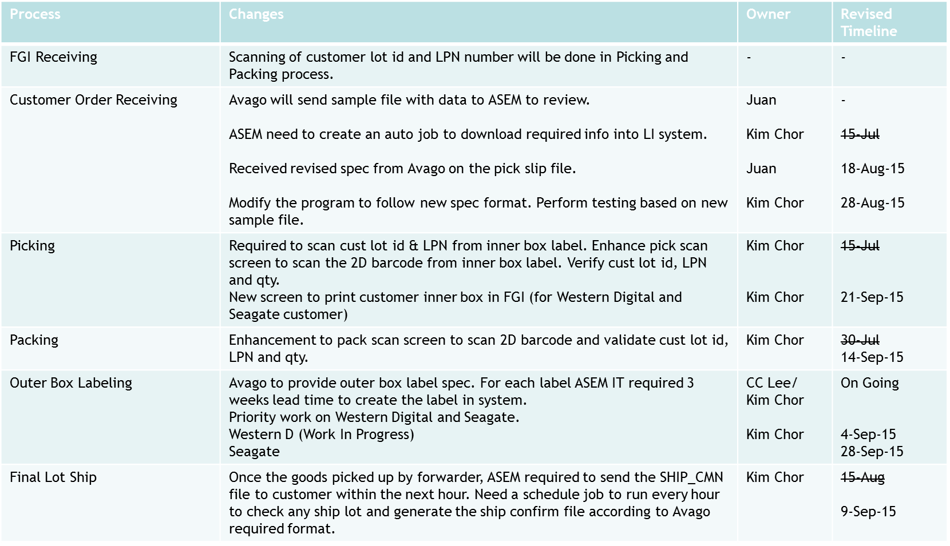

Summary Project Timeline

